Slide 1
AutoPen Sprint 2 Demo
By: Caleb Hall, Calla Robison, Michael Allen, Myles Scott, Joshua Buscher

Slide 2
Presentation Overview
Completed tasks
Demo
Problems
Whats next?
Q&A

Slide 3
Team Assignments
Michael: Documentation and AI
Caleb: Pentesting AI
Joshua: Documentation
Myles: Documentation
Calla: Web and Cloud Development

Slide 4
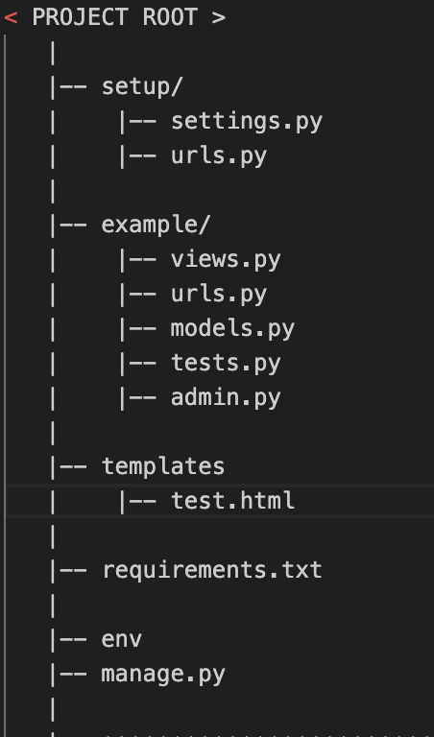
So What was Completed?
Created Django codebase structure for AutoPenSite
Initial scanning functionality
Wmap
Documentation
SDDv2
SRSv2
Test Plan

Slide 5
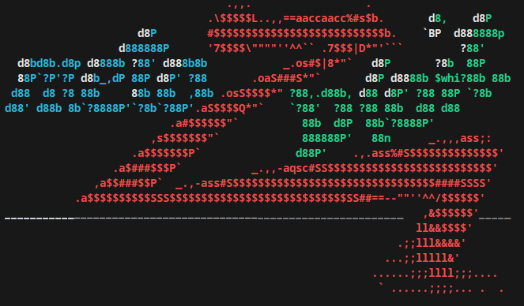
AI Demo

Slide 6


AI Demo

Slide 7

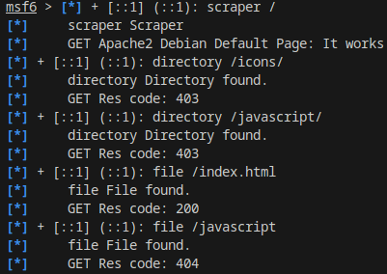
AI Demo

Slide 8
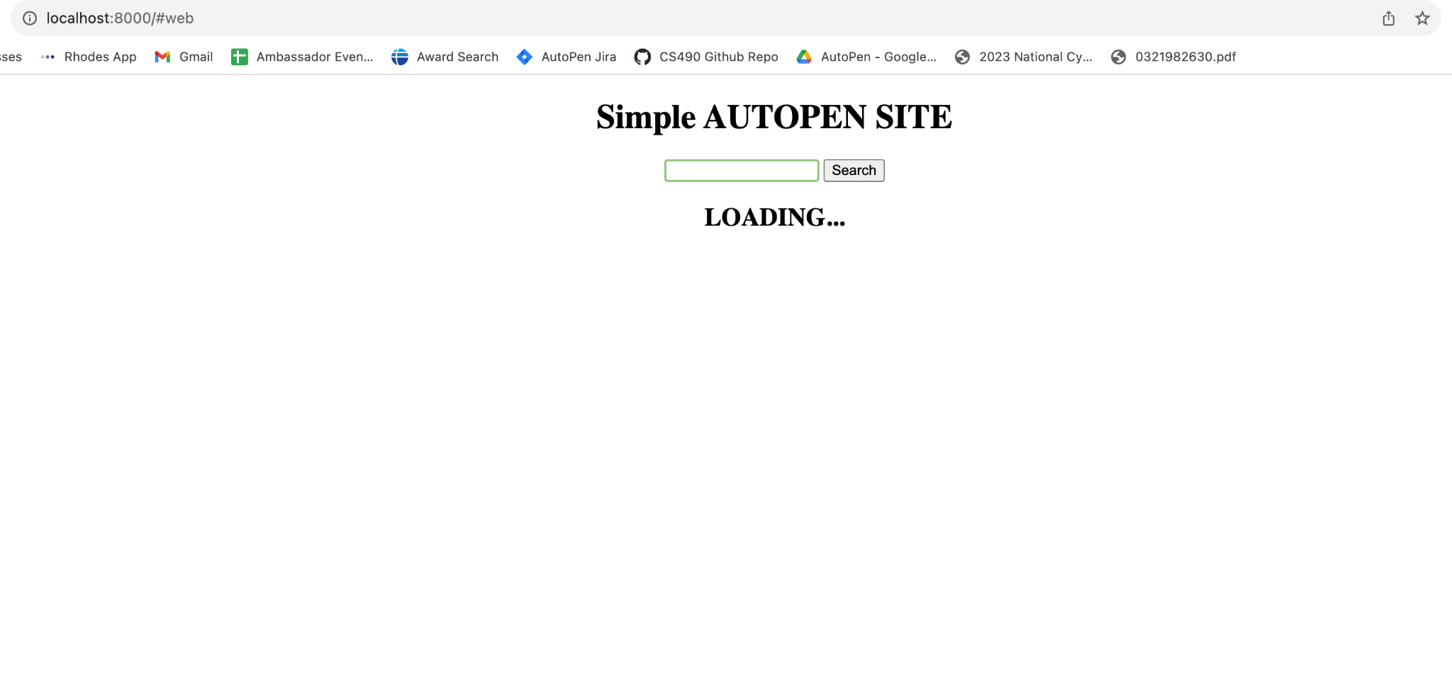
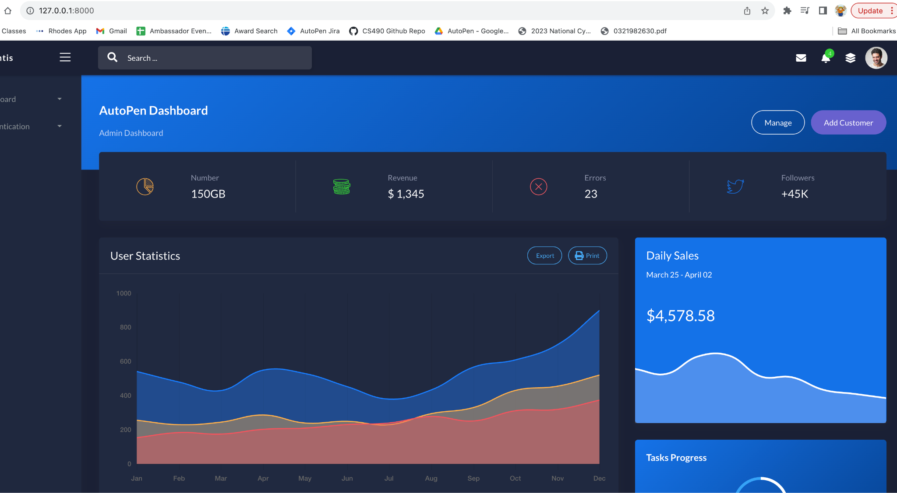
Our Website

Slide 9
Problems
Finding a decent and cost effective cloud host
Heroku
DigitalOcean
Microsoft Azure
Sitegrounds
AI
Code required authentication
Deepsploit
Pymetasploit3
No I in AI

Slide 10

What’s Next?
Review Previous Sprint
What worked well? What didn’t work well?
Process improvements?
System Design improvements?
Connect Website front end to the Script Backend using digital ocean droplets
Touch Up Website
Refine Algorithm
Exploitation
New modules

Slide 11

Questions

